Slide 1

Hello!
I am Sheila Fitria Al’asqalani
Graduate of Informatics Engineering at University of Muhammadiyah Malang
sheilaftria@gmail.com
Linkedin
Github

Slide 2
Automatic Summarization of Court Decision Documents over Narcotic Cases Using BERT

Slide 3
Outline
1
Introduction
2
Literature Study
3
Methodology
4
Result and Discussion
5
Conclusion

Slide 4
1. INTRODUCTION

Slide 5
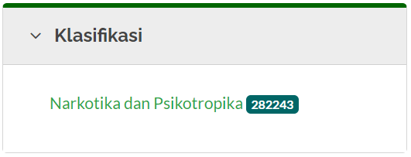
INTRODUCTION
BIG DATA
March 2022
THE SUMMARY METHOD
Extractive single-document summarization on court decision documents on narcotic and psychotropic substance
WHY BERT?
Simple and powerful
Beneficial

Slide 6
2. LITERATURE STUDY

Slide 7
LITERATURE STUDY
 | Datasets | Method | Result
1 | CNN / Daily Mail New York Times | BERT and Transformer Based Decoder | CNN / Daily Mail dataset : R1 41.71 & R2 19.49, New York Times dataset : R1 45.33 & R2 26.5
2 | CNN / Daily Mail | BERT abstractive and extractive single-document summarization | Evaluation using ROUGE F1 obtained ROUGE-1 41.76; ROUGE-2 19.31; & ROUGE-L 38.86
3 | COVID-19 Open Research Dataset Challenge | BERT and OpenAI GPT-2 | extractive summarization produced a higher ROUGE score than did those of abstractive summarization
4 | lecturer’s material | BERT for extractive summarization and K-Means clustering to identify sentence selection choices | The extractive summarization is still not perfect, but compared to TextRank, BERT has a steady increase in summary quality and the integration of context with meaningful sentences

Slide 8
3. METHODOLOGY

Slide 9
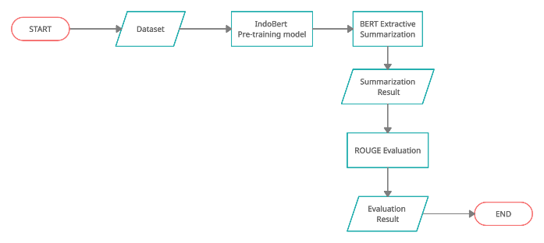
RESEARCH FLOW

Slide 10
4. RESULT & DISCUSSION

Slide 11
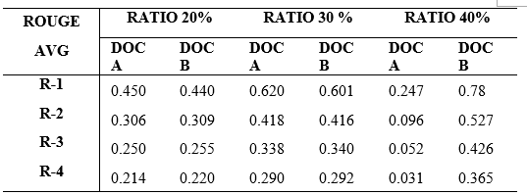
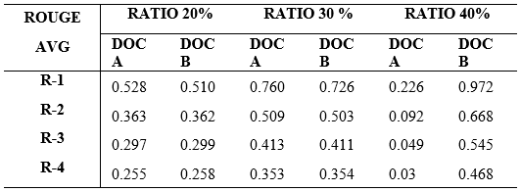
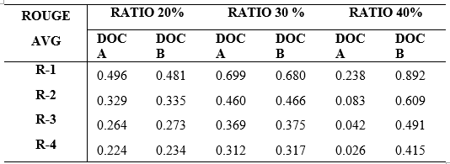
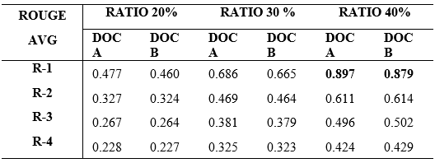
RESULT

Slide 12
5. CONCLUSION

Slide 13
CONCLUSION
IndoBERT successfully summarized the court decision document over narcotics case. IndoBERT-Lite-Large Phase 1 pre-training model had a better performance in summarizing court decision documents with or without the defendant’s identity with a 40% summarizing ratio, and the best evaluation method to evaluate the summarization result is ROUGE-N with N=1

Slide 14
Thanks!
Any questions?

